Slide 1





MARCH MADNESS DATA CRUNCH
mRCH MADNESS DATA CRUNCH
FOURdham MARCHKETEERS
Sumi Choudhury Wen Zhang
Chuanyue You Minxia Ji

Slide 2
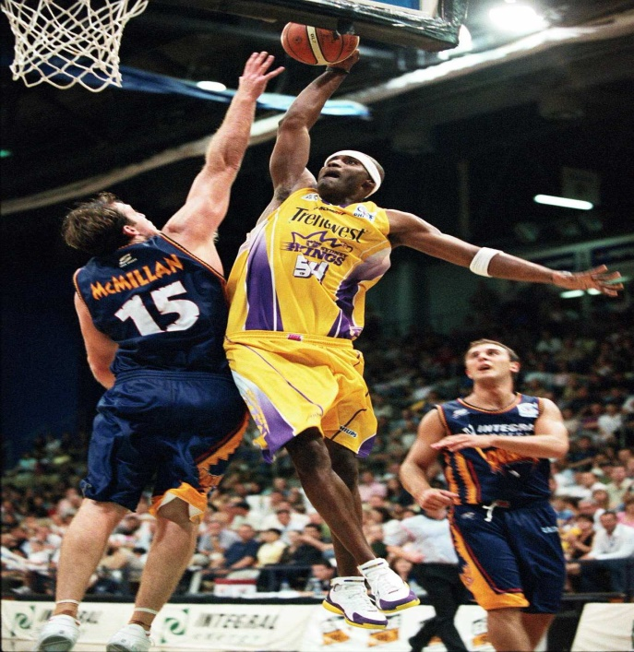
Introduction
The March Madness Data Crunch Challenge
BKGD
BKGD
Background
The NCAA Men's Basketball Division I Tournament is a single-elimination tournament played each spring in the U.S., currently featuring 68 National Collegiate Association (NCAA) basketball teams, in order to determine the national championship.
GOAL
OBJ
Objective
Using data mining and machine learning techniques, FOURdham Marchketeers will choose the best model to predict the winning brackets for this year’s competitions.

Slide 3
Analysis Process
Data Preprocessing
Feature Selection
Modeling
Summary
Data Cleaning
Reactive Data Visualization
Model Building
Interesting Analysis
Polynomial SVM
Logistic Regression
Artificial Neural Network
Decision Tree
Naive Bayes
Add Distance
& AdjEM
Domain Knowledge
Conclusion
Manhattan Distance
Euclidean Distance
Features Analysis
Suggestions
Data Transform
Correlation Matrix
Distribution
Delta
Adjusted Seed
Model Evaluation
ROC Curve
Performance Validation (Log loss)
Recursive Elimination
Feature Scaling
Standardization
Model Improvement
Learning Curve
Feature Reselection

Slide 4


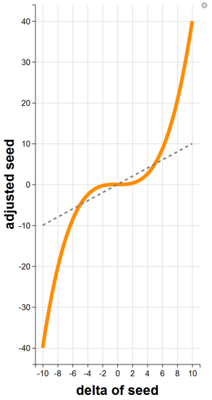
Data Preprocessing
Add Distance
& AdjEM
Delta
Adjusted
Seed
Feature
Scaling
Manhattan Distance:
Interpretation
Idea
Standardization
|host_lat - team_lat| + |host_long-team_long|
Delta means the difference between TEAM1 and TEAM2 on a specific attribute
Enlarge delta of seed when it is large; decrease when it is small
Makes the values of each feature have zero-mean and unit variance
Euclidean Distance:
sqrt ( |host_lat - team_lat|^2 + |host_long-team_long|^2 )
e.g.
Formula
Delta of seed = team1_seed - team2_seed
Formula
X_{i}' = ( X_{i} - mean(X) ) / sd(X)
Euclidean Distance surpasses Manhattan Distance in our models
adjusted seed = 0.04 * ( delta seed )^3
AdjEM:
Adjusted Efficiency Margin
AdjEM = AdjOE -AdjDE

Slide 5
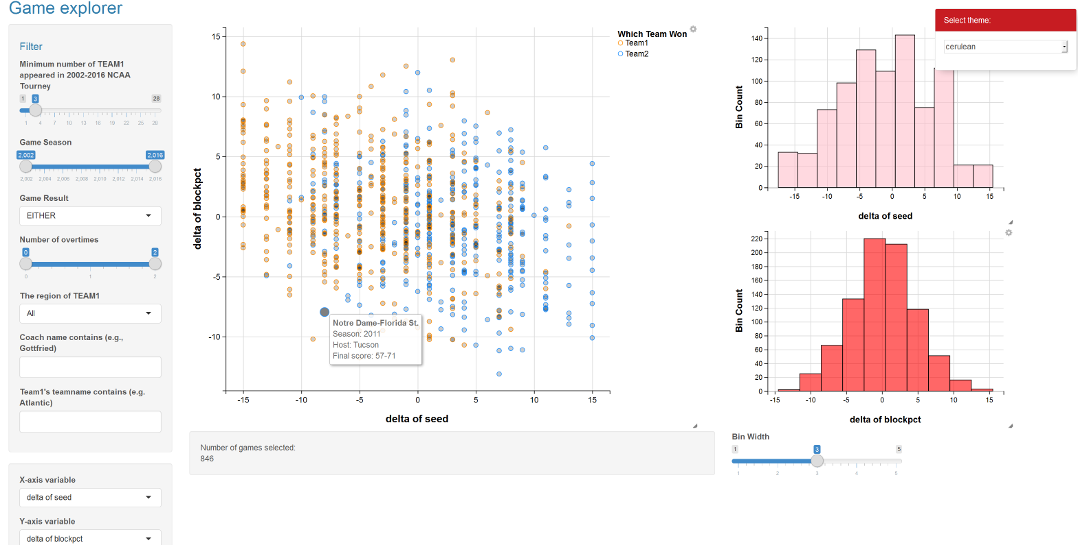
Reactive Data Visualization
powered by R Shiny
intro
Game Explorer
FOURdham Marchketeers designed a unique web app for game data visualization. It can filter game data by frequency of which team1 appeared in dataset, game season, result, team name, coach name, etc. Choose whatever x/y variable you want and try it out!
https://fourdhammarchketeers.shinyapps.io/shiny/

Slide 6
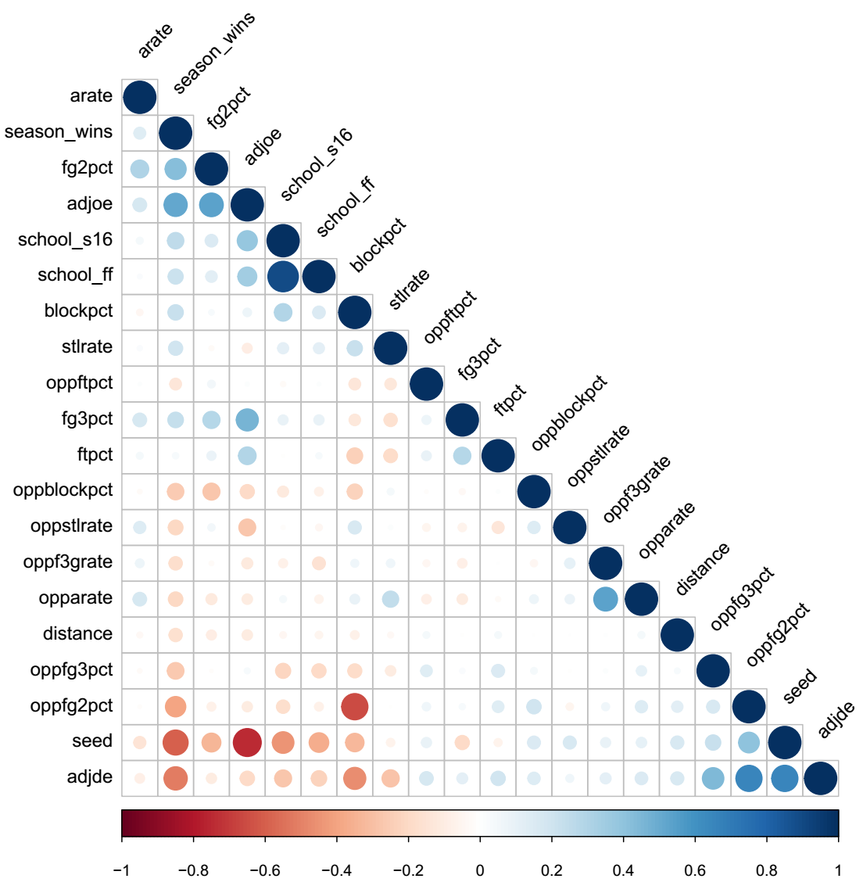
Feature Selection
65%
CM
Correlation Matrix
Range = -1 to 1
-1/1 = Perfect Negative/Positive Correlation
0 = No Correlation
Blue = Postive Correlation
Red = Negative Correlation
Color Intensity & Size = Proportional to Correlation
！
Notice
Few features have linear correlation
Be careful when choosing these features

Slide 7
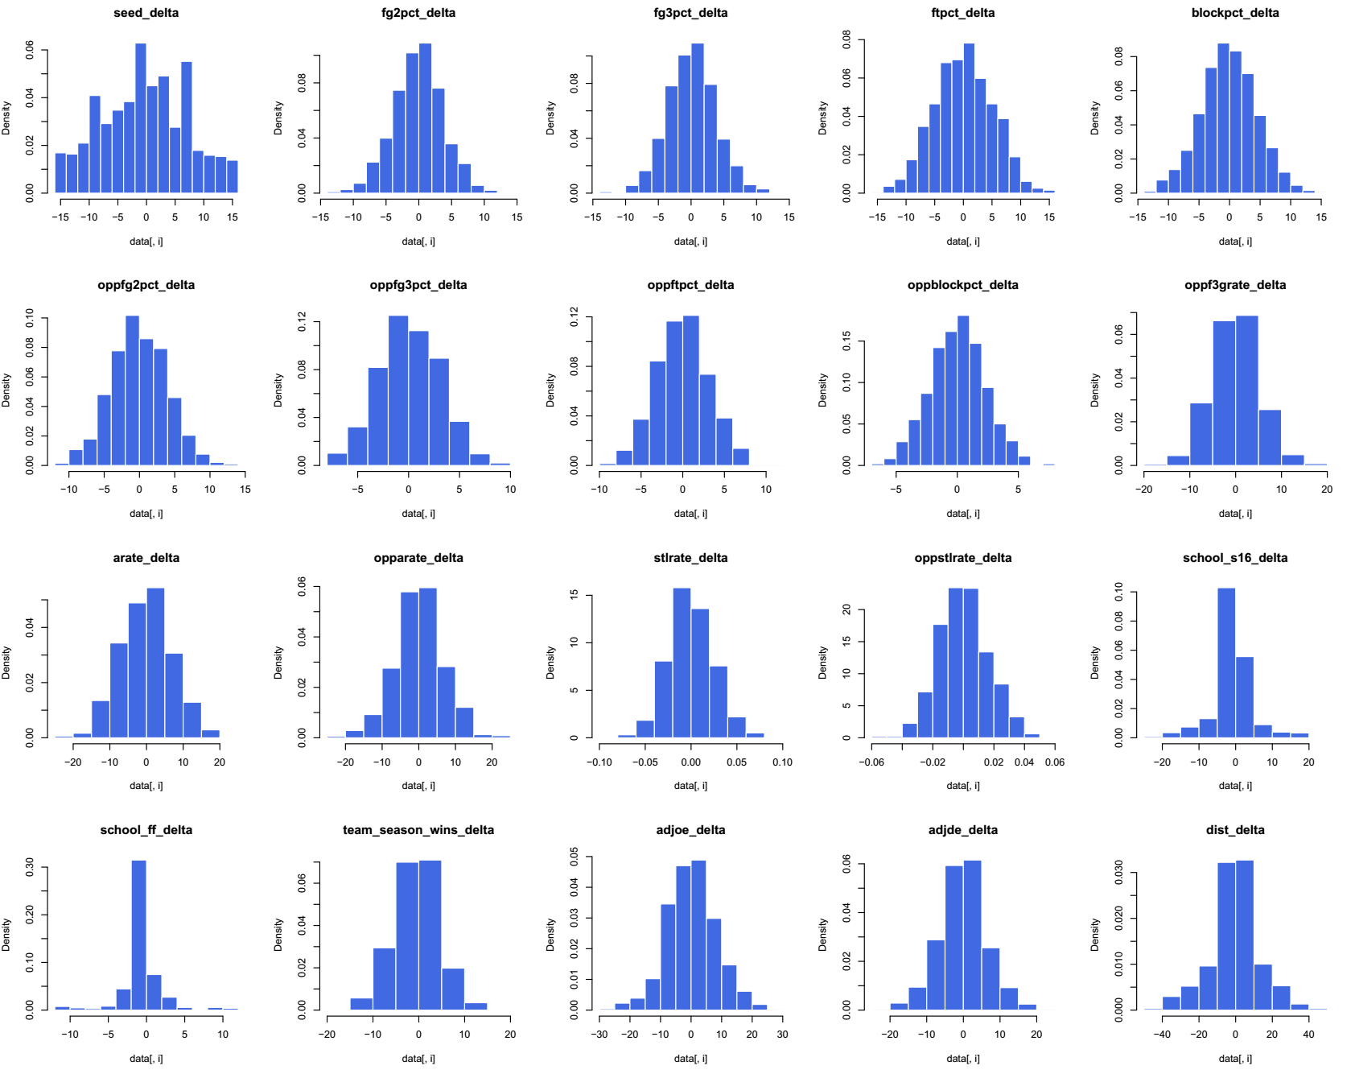
Feature Selection
65%
FDH
Feature Distribution
Histogram
Most features are normally distributed
99 6
Collapse 99 Features to 6
Seed, adjoe, adjde, oppf3grate,
blockpct & dist

Slide 8
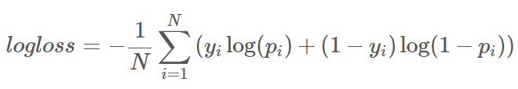
Optimization Objective
Minimizing the Log loss
fx
N = number of games played
Pi = predicted probability that team 1 beats team 2
Yi = 1/0 depending on whether team 1 wins / team 1 loses
Log loss heavily penalizes predictions that are both confident and wrong
Create an optimal model by minimizing log loss!
Luck
What's Luck Got To Do With It?
Some models can exhibit higher accuracy
compared to its log loss in testing due to major game 'upsets'

Slide 9
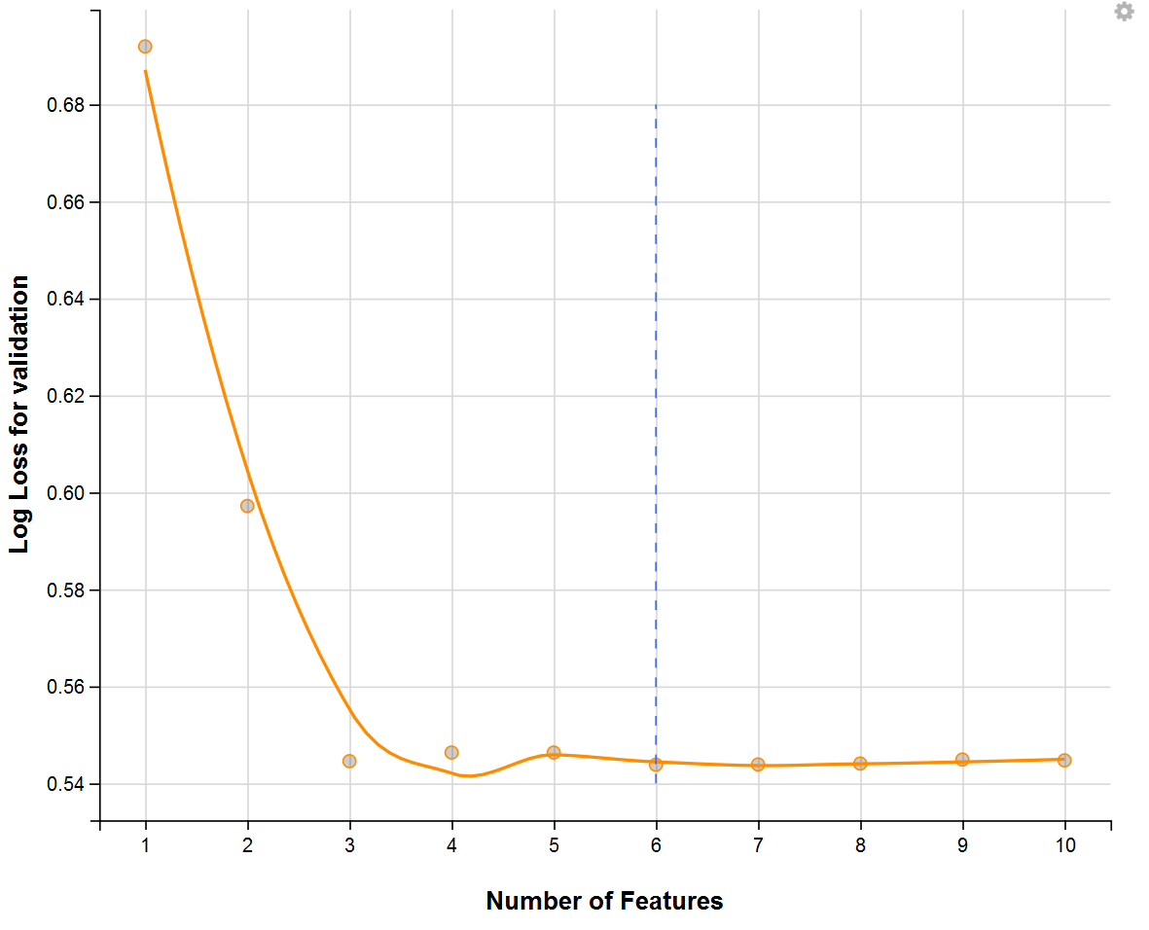
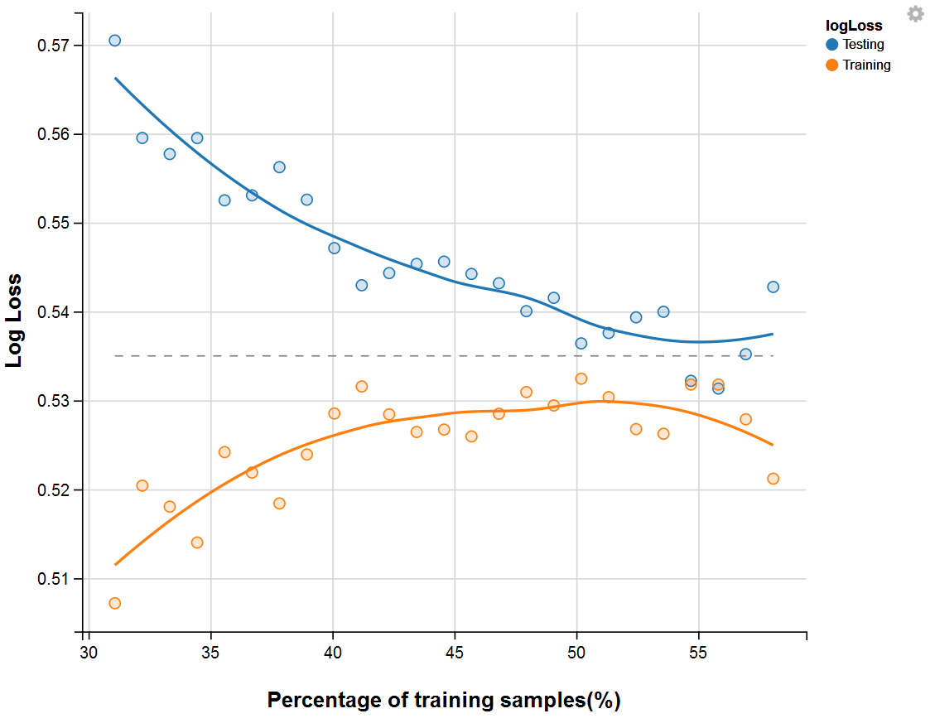
Model Improvement
LC
Learning Curve
Partition ratio is equal to 53:47 (Training:Testing),
testing set reaches desired log loss
FS
Feature Selection
Number of features selected is equal to 6,
touching the minimum log loss for validation

Slide 10
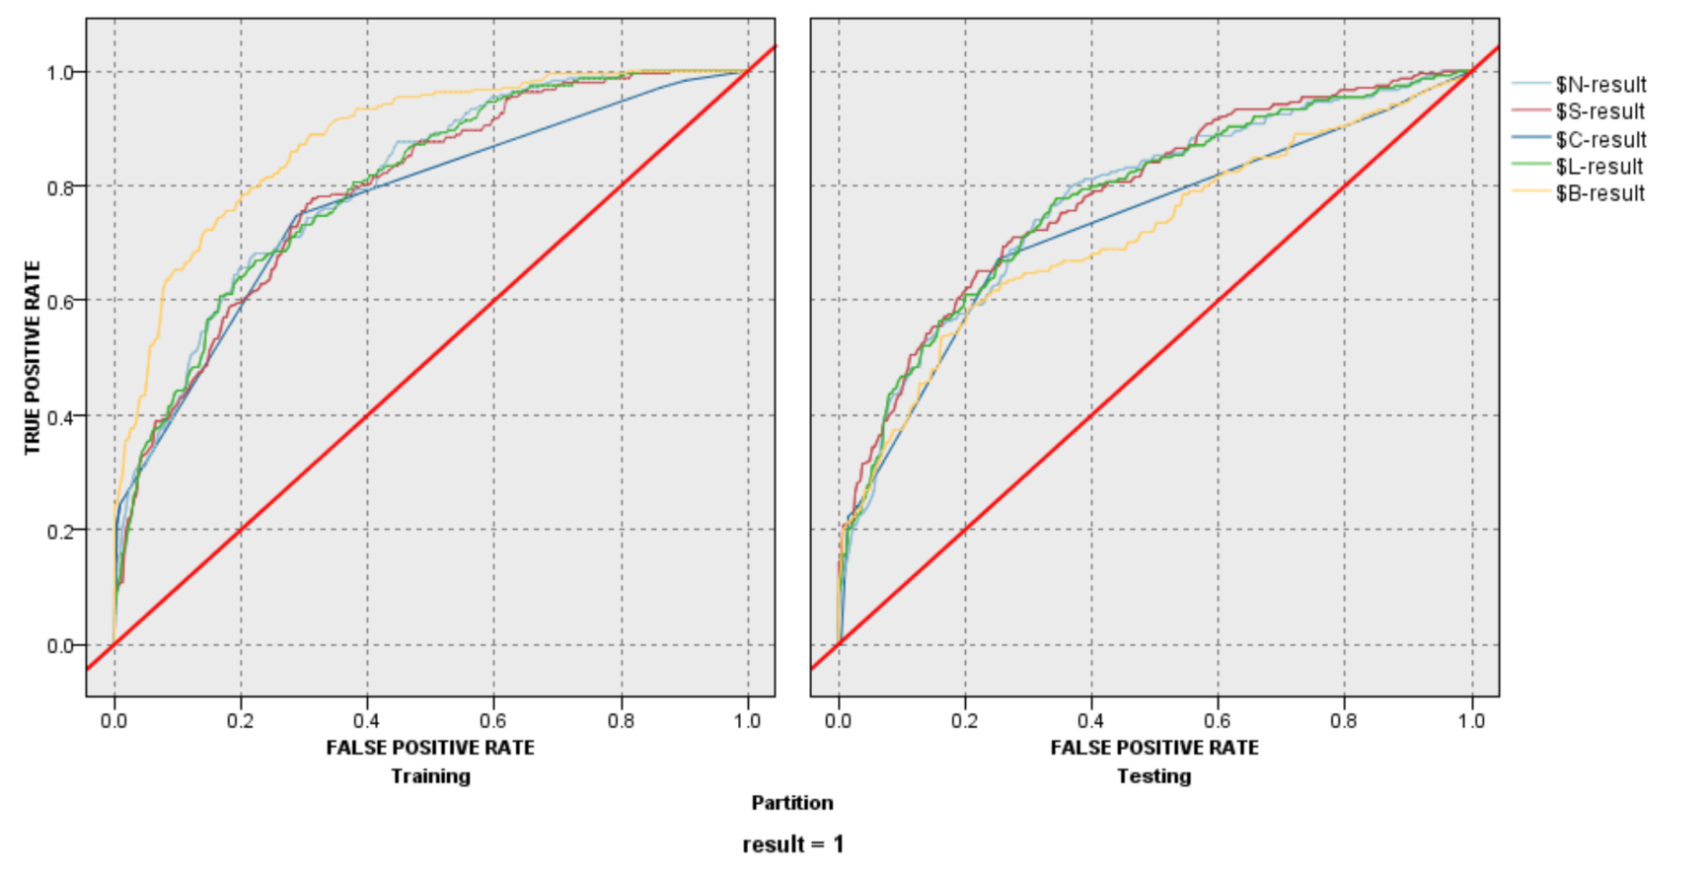
Model Evaluation
ROC
ROC Curve
Polynomial SVM is slightly better
than other models in Testing.
MODEL | LOG LOSS | ACCURACY
Polynomial SVM | 0.537 | 72%
Logistic Regression | 0.539 | 71.2%
Artificial Neural Network | 0.556 | 71%
Decision Tree | Not Applicable | 71.2%
Naive Bayes | 0.690 | 68.3%
Performance Validation _{(Log loss)}
PV
Once again, Polynomial SVM has
lowest log loss together with highest accuracy.
ENS
Ensemble
Confidence-Weighted Voting
among TOP 3 models (SVM, LR & ANN)

Slide 11
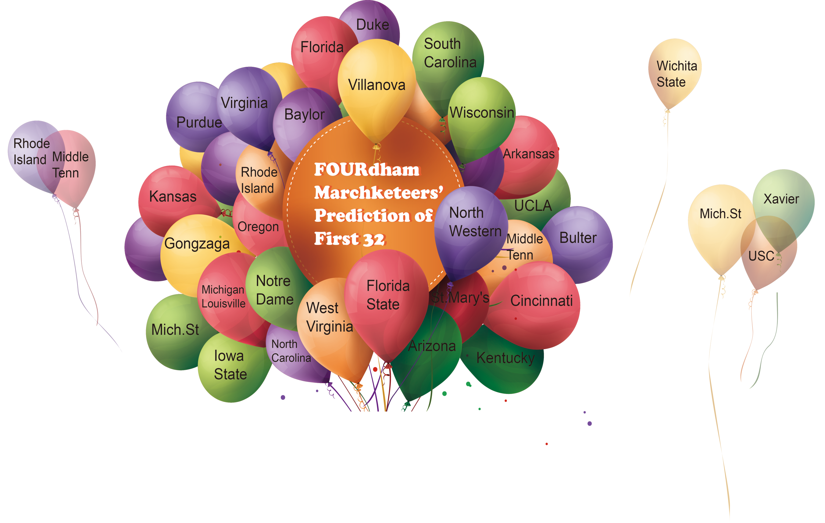
Prediction for 32
Accuracy:81.25%
26 correct
6 wrong

Slide 12
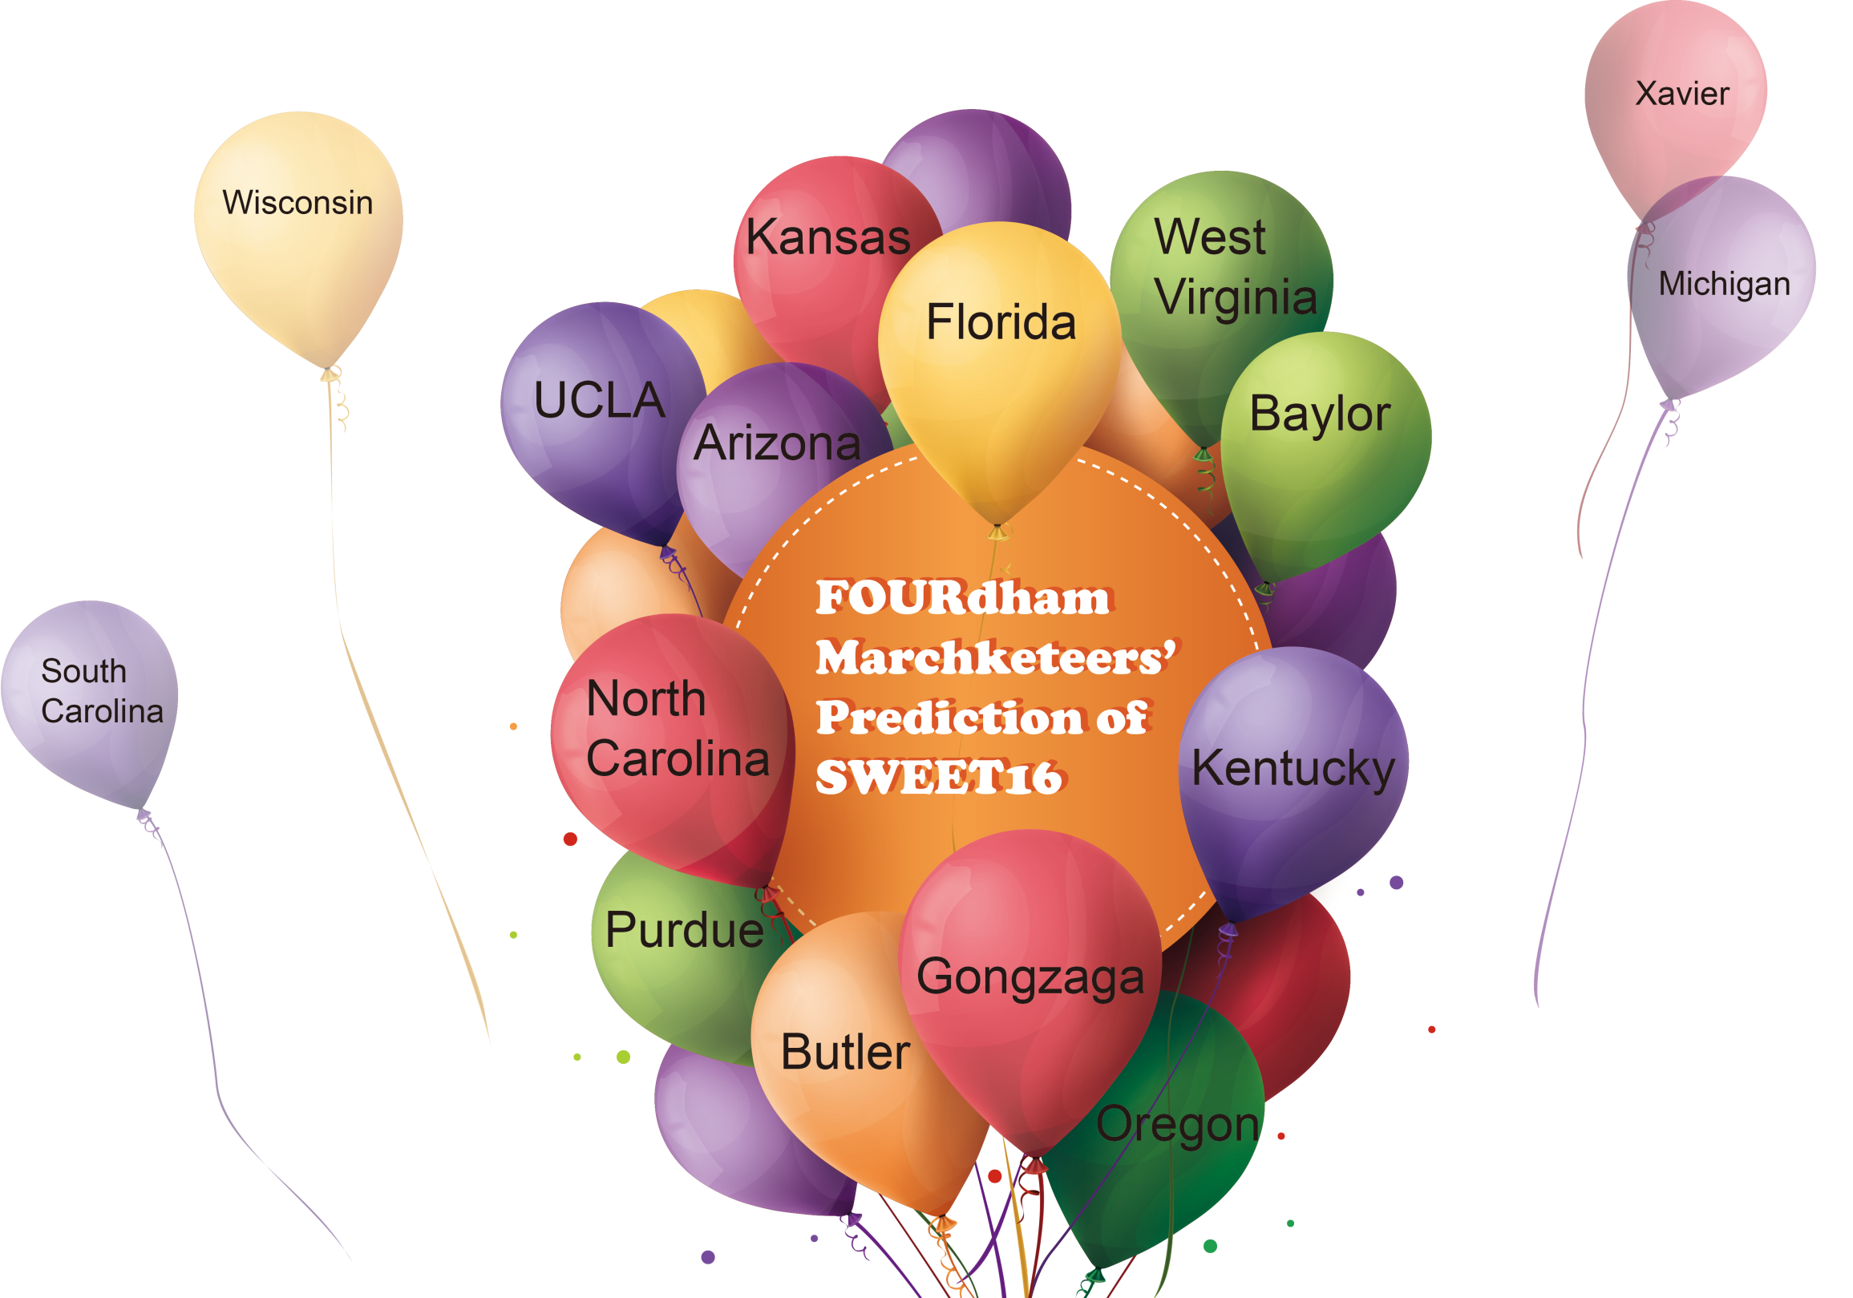
Prediction for SWEET 16
Accuracy:75%
12 correct
4 wrong

Slide 13
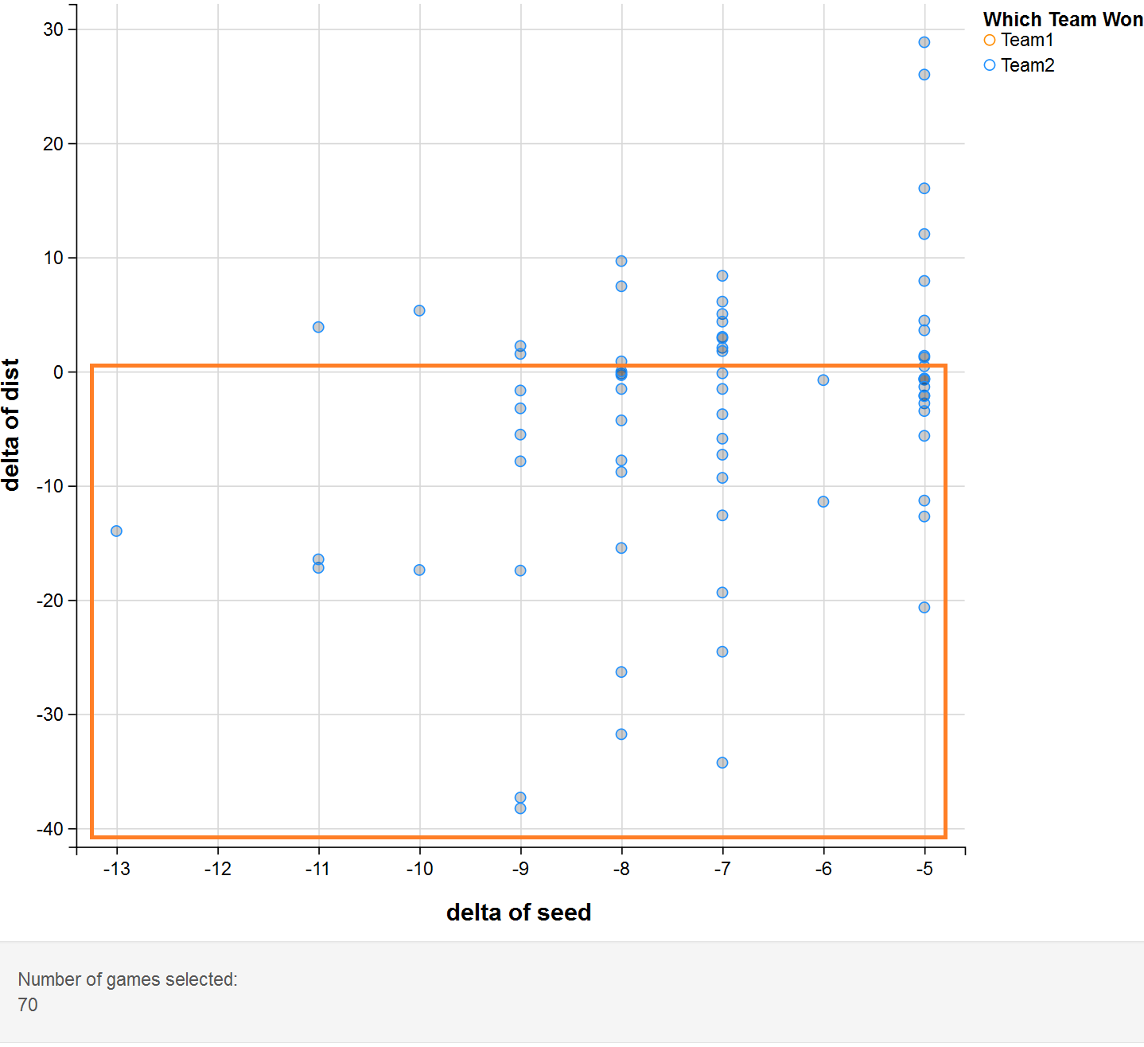
Interesting Analysis
How we did the analysis
Two Conditions in selecting games:
1) delta of seed ≤ -5, which means Team1 had much better seed than Team2
2) only blue points, which means Team1 lost the game (even though Team1 was expected to win due to its better seed)
Our Intuition
Team1's failure may be related to some unfavorable outside reasons (e.g. far away from the host city)
In Fact
we find just the opposite! In the majority of these games (marked by orange rectangle), Team1 was closer to the host city than Team2
Notice!
Be careful about predicting the results of these games in which one of the teams has both better seed and distance advantage

Slide 14
Conclusion
SEED is an important indicator, but sometimes might mislead
Adding these following features have greatly helped our prediction model:
OA
Opponent Attributes
EM
Efficiency Metrics
Percentage of Opponent's 3-Point Field Goal Attempts
Adjusted Offensive Efficiency
Adjusted Defensive Efficiency
Block Shots Percentage
GA
Game Attributes
Distance of Host Location from Team’s Home Campus
FOURdham Marchketeers' Prediction Accuracy
Up Until Now: 79.17%

Slide 15
Suggestions
The addition of the following data may have been helpful:
1
Team’s level of confidence and preparedness for the Tournament
2
NCAA rule changes, such as an additional 9-inches extension of the three point line in 2007
3
Non-traditional data such as Experience: A team with more Seniors and Juniors receives a higher Experience ranking than a team that consists mostly of Freshmen and Sophomores
4
Campus Support: Measured by the average attendance at home games throughout the course of a season

